Slide 1
VENN Diagrams
EQ – How do we sort data using Venn Diagrams?
Year 10 Mathematics

Slide 2
Lesson objective
By the end of this lesson you will be able to;
Construct and uses venn diagrams to calculate probabilities
List outcomes for two and three-step chance experiments using tree diagrams, 2 way tables (arrays) and Venn diagrams as required, with or without replacement, and calculate the probability of outcomes.
Notes:
Lesson

Slide 3
24
7
30
Topic: Venn Diagrams
Date: 14/06/2018
EQ – How do we sort data using Venn diagrams?
Venn Diagrams are used to compare and contrasts sets of data. A set is a collection of items that have something in common and are written inside curly brackets, { }.
Multiples of 3
Even numbers
These numbers needed to be sorted into multiples of 3 and even numbers
3
5
7
10
13
15
18
24
25
27
30
36
40
50

Slide 4
A VENN DIAGRAM IS USED TO SORT THINGS
Multiples of 3
Even numbers
Numbers that are multiples of 3 and even numbers go here because they belong to both circles...
3
5
7
10
13
15
18
24
25
27
30
36
40
50

Slide 5
A VENN DIAGRAM IS USED TO SORT THINGS
Multiples of 3
Even numbers
Numbers that are not multiples of 3 and not even, stay on the outside.
3
5
7
10
13
15
18
24
25
27
30
36
40
50

Slide 6

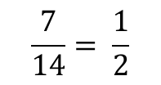
A VENN DIAGRAM IS USED TO SORT THINGS
Multiples of 3
Even numbers
5
27
36
10
13
15
50
24
30
3
7
18
40
25
Numbers that are not multiples of 3 and not even, stay on the outside.
P(multiple of 3) =
$$\frac{7}{14}= \frac{1}{2}$$
P(only even number) =
$$\frac{3}{14}$$

Slide 7
A VENN DIAGRAM IS USED TO SORT THINGS
Multiples of 3
Even numbers
Multiples of 3 go inside this circle
3
5
7
10
13
15
18
24
25
27
30
36
40
50

Slide 8
A VENN DIAGRAM IS USED TO SORT THINGS
Multiples of 3
Even numbers
Even numbers go inside this circle
3
5
7
10
13
15
18
24
25
27
30
36
40
50

Slide 9
We can use the Venn diagram this way to collect and organise the categories, but it can be really messy! So normally you would see a total number inside the box/circle to tell you how many values are in that section, or even listing the probability.

Slide 10
Class activity
Find out how many people in the class are Boys?
How many people are 15 years old?
How many people are there in the class?
How many people in the class are not 15 yrs old and are not boys?
We now have everything we need to get organised and find some probabilities!
Notes:
Make sure that you write these numbers to the side of the board to make constructing the class venn diagram for comparison easier.

Slide 11
Organising your Venn diagram
Now that we have our numbers we need to build out “universe”
Step 1 is to draw our “universe” – the box that contains everything!
Boys | 15ys | Not boys and 15yrs | Whole class

Slide 12
Organising your Venn diagram
Now that we have our numbers we need to build out “universe”
Step 2 – work out how many circles will represent this information. One circle for each category. Draw them in and label them.
Boys | 15ys | Boys’ ∩ 15yrs’ | Whole class

Slide 13
Organising your Venn diagram
Now that we have our numbers we need to build out “universe”
Step 3 – Organise numbers into the circles. How many people in the class did not fit into the circles? How many are boys and how many are 15yrs?
Boys | 15ys | Boys’ ∩ 15yrs’ | Whole class
Boys
15 yrs

Slide 14
Organising your Venn diagram
Now that we have our numbers we need to build out “universe”
Step 4 – Check your numbers by adding them up and making sure that they equal the whole class number. Does it add up? You might has some people in the overlap that are both boys and 15 yrs old.
Boys | 15ys | Boys’ ∩ 15yrs’ | Whole class
Boys
15 yrs
Notes:
If you take away the people who are neither from the class total, you should have what the 2 circles together add up to (union). If you take all of the boys from that number (union), you will get the number that goes into the only 15 yrs section.
If you take the number of 15 yrs from the total of the circles (union) then you will get the number only in the boys section and then you can work out the overlap.

Slide 15
Probabilities - LHS
What is the probability of being a boy in our class?
What is the probability of being a 15 yr old in our class?
What is the probability of being a 15 yr old that is not a boy?
What is the probability of being not 15 yr old and owning a cat?

Slide 16
LHS Question
What would our class Venn diagram look like if those people who were boys AND 15yrs old were absent today?
Draw the new diagram in your LHS

Slide 17
It should look something like this, a mutually exclusive event!
Boys
15ys

Slide 18
24
7
30
Topic: Venn Diagrams
Date: 14/06/2018
EQ – How do we sort data using Venn Diagrams?
Definitions:
A
B
The intersection is where two sets overlap.
This means A and B.
A
B
If you put two sets together, you get the union.
This means A or B.

Slide 19
24
7
30
Topic: Venn Diagrams
Date: 14/06/2018
EQ – How do we sort data using Venn Diagrams?
Definitions:
A
B
The complement of A is the region that is not A.
This means not A.

Slide 20


Slide 21
Example In a class of 30 students, 19 study physics, 17 study chemistry and 15 study both. Use a Venn diagram to display this information.
Physics
Chemistry
P(P and C) = P(P∩C) =
P(P or C) = P(P∪C) =

Slide 22
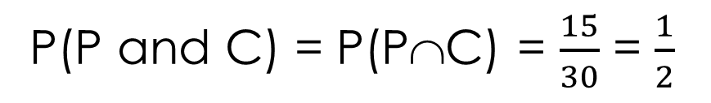
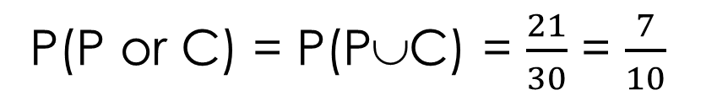
Example In a class of 30 students, 19 study physics, 17 study chemistry and 15 study both. Use a Venn diagram to display this information.
Physics
Chemistry
4
15
2
9
P(P and C) = P(P∩C) = $\frac{15}{30}$ = $\frac{1}{2}$
P(P or C) = P(P∪C) = $\frac{21}{30}$ = $\frac{7}{10}$

Slide 23
Task
1) Nelson WA Maths 10, Ex 6.2 p. 248 Questions 13, 14 and 20 or Dwyer Year 10 Text, Exercise 8.5, Questions 1-3, p.108
2) Add Venn diagram, Intersection and union to your glossary
3) Complete the worksheet

